Slide 1
STYLEHIVE : BUSINESS RELATIONSHIP MANAGEMENT
SUPPLIERS
INTERNAL OPERATIONS
CUSTOMERS
Internal Stakeholders
Product Management
(Stylehive)
Advertising Partners
Customer Support
(StyleHive)
Basic Users
(Stylehive)
Logistics
Advertising Management
(Stylehive)
Premium Subscribers
(Stylehive)
Internal Operations directly interact with customers
Payment Processors
Finance Management
(Stylehive)
E-commerce management and product vendors
E-commerce Management
(StyleHive)
Data Providers and analytics tools
Data Analyst
(Stylehive)
Supply Chain Partners and Transportation providers
Supply Chain Management
(Stylehive)

Slide 2
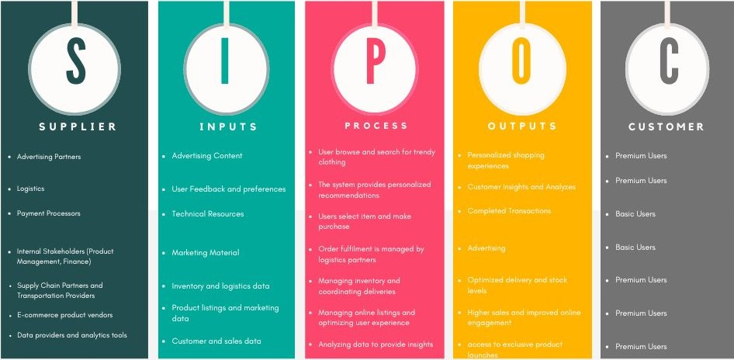
SIPOC DIAGRAM

Slide 3
USER ROLES BY BUSINESS GROUPS
EXTERNAL USERS
Basic Users | Lokesh
Lifestyle Enthusiasts | Rithika
INTERNAL USERS
Business Group | User Roles | Team Member Name (Bus.Group Proxy)
Product Manager | Manager | Vyshnav
Finance Management | Accountant | Deepak
Customer Support | Customer Service Representative | Susmitha
Advertising Management | Sales Promotion | Lokesh
Supply Chain Management | Logistic manager | Nikunj
E-commerce Manager | Online sale manager | Priyanshu
Data Analyst | Subject Matter Expert | Divya

